Slide 1
305.5 - Hibernate Mapping and Relationship / Association

Slide 2
Hibernate Mapping
and
Relationship Association
Learning Objectives:
This lesson will take you through an example of mapping or association using JPA and Hibernate annotations.
By the end of this session, learners will be able to:
Demonstrate how to work with relationships between entities in Hibernate.
Describe the relationships and mapping annotations in JPA and Hibernate.

Slide 3
Table of Contents
Hibernate Mapping and Relationship Overview.
Annotations - Hibernate Mapping and Relationship
Hibernate Mapping and Relationship Example.
Unidirectional and bidirectional Association/Mapping.
Many-to-One Relationship.
Many-To-One Relationship Example.
One-to-Many Relationship.
One-to-Many Relationship Example.
One-to-One Relationship.
One-to-One Relationship Example.
Many-to-Many Relationship.
Many-to-Many Relationship Example.

Slide 4
Hibernate Mapping and Relationship Overview
Hibernate is an object-relational mapping tool for the Java programming language. It provides a framework for mapping an object-oriented domain model to a relational database. Hibernate can treat entities as both object-oriented classes and relational tables, and it is possible to create relationships between entities. The relationship between the two entities is called association.
Hibernate mapping establishes the relationship (association) between tables as attributes in entity classes (model classes) that allow you to easily navigate the associations in models and queries. The relationships (associations) that can be established between entities include:
one-to-one — represents the one-to-one relationship between two tables.
one-to-many/many-to-one — represents the one-to-many relationship between two tables.
many-to-many — represents the many-to-many relationship between two tables.
Each relationship can be mapped as a unidirectional or bi-directional relationship, which means that they can be modeled as an attribute on only one of the associated entities, or on both. This has no impact on database mapping, but it does determine in which direction the relationship can be used in the domain model and HQL.

Slide 5
Annotations - Hibernate Mapping and Relationship
Annotation | Description
@ManyToOne | Defines that many of this entity can exist in another entity and stores that entity as a variable (e.g., staff can exist in a department; a relationship between a student and a library, in such a way that more than one student can be issued the same book).
@OneToMany | Defines that many other entities can relate to one of this entity and stores the entities in a list (e.g., department can have one-to-many staff; a relationship between a student and a library, in such a way that one student can be issued more than one type of book from the library).
@OneToOne | Only one of this entity can belong to one of another entity (e.g., Staff -> Teaching Staff or Non-Teaching Staff; relationship between a student and a library, in such a way that one student can be issued only one type of book).
@ManyToMany | Many of this entity can belong to many of another entity (e.g., Teachers -> Courses; relationship between a student and a library, in such a way that any number of students can be issued any type of book).
 | Note: many-to-one and one-to-many associations represent the same association from two different perspectives; it depends on which side of the relationship the entity is present.

Slide 6
Additional Annotations
What is Cascading?
Entity relationships often depend on the existence of another entity. For example, a person–address relationship is dependent. Without the person, the address entity does not have any meaning of its own. When we delete the person entity, the address entity should also get deleted.
This is achieved through Cascading. When performing an action on a target entity, the same action will be applied to the associated entity. Cascade types include ALL, PERSIST, MERGE, REMOVE, REFRESH, and DETACH.
Example:
@ManyToOne(cascade = CascadeType.PERSIST)
Click here for more information about JPA/Hibernate Cascade Types.

Slide 7
Example: Hibernate Mapping and Relationship
The Entity Classes (Models):
Teacher
▶ The individual teachers.
Department
▶ The department to which the teacher belongs.
Credentials
▶ The login information for each teacher.
Assigned Course
▶ The courses that the teachers are assigned.
Relationships:
Teacher -> Department (Many → One)
Department -> Teacher (One → Many)
Teacher -> Credentials (One → One)
Teacher -> Assigned Course (Many → Many)

Slide 8
Unidirectional and bidirectional Association/Mapping
The Association/Mapping can be either Unidirectional or Bidirectional.
Unidirectional Association:
Unidirectional association means that only one entity has a relationship field or property that refers to the other. The source entity has a relationship field that refers to the target entity, and the source entity’s table contains the foreign key.
Note: In this course, we will implement only uni-directional entity mapping using Hibernate.
Bidirectional Association:
The term “bidirectional” literally means “functioning in two directions. In a bidirectional association, each entity (i.e. source and target) has a relationship field that refers to each other and the target entity’s table contains the foreign key. The source entity must use the mappedBy attribute to define the bidirectional mapping.
Visit for more details: https://docs.jboss.org/hibernate/core/3.6/reference/en-US/html/associations.html

Slide 9
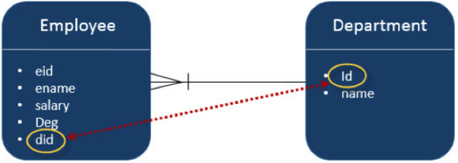
Many-To-One Relationship
In Hibernate, there are two ways to create Many-to-One relationships between entities:
Use Foreign Key association (we will use this technique in this course).
Use JOIN table.
Let’s consider an example of the relationship between the Employee and Department entities. In a unidirectional manner (i.e. from Employee to Department - many-to-one relationship is applicable). This means that each employee record contains one department id, which should be a primary key in the Department table. Here in the Employee table, Department id is the foreign Key (did).
source: javatell.com

Slide 10
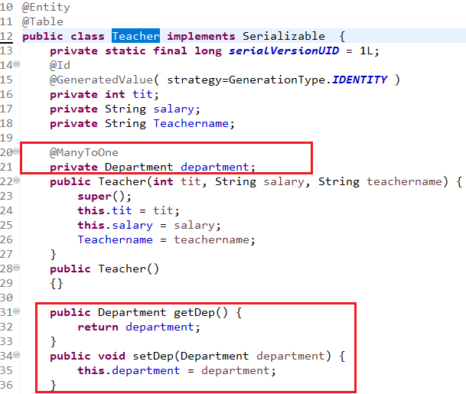
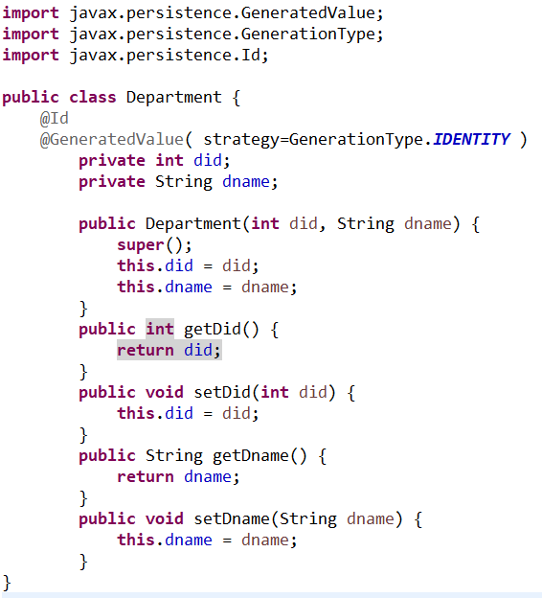
Example: Many-To-One Relationship
Teacher Class
Department Class
continued
The @ManyToOne annotation is to establish a many-to-one relationship between TEACHER and DEPARTMENT entities. We annotate the Department field inside the Teacher class with @ManyToOne.
Notes:
The code shown above is just a screenshot; the full code will be shown in the next lab. Instructor have to provide the Demonstration to ManytoOne relationship

Slide 11
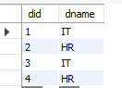
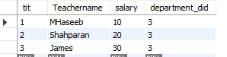
Example: Many-To-One Relationship (continued)
public class App {
public static void main(String[] args) {
SessionFactory factory = new Configuration().configure().buildSessionFactory();
Session session = factory.openSession();
Transaction t = session.beginTransaction();
//Creating Department
Department dep = new Department();
dep.setDname("IT");
Department dep2= new Department();
dep2.setDname("HR");
//Creating teachers
Teacher t1 = new Teacher();
t1.setDep(dep);
t1.setSalary("10");
t1.setTeachername("MHaseeb");
Teacher t2 = new Teacher();
t2.setDep(dep);
t2.setSalary("20");
t2.setTeachername("Shahparan");
Teacher t3 = new Teacher();
t3.setDep(dep);
t3.setSalary("30");
t3.setTeachername("James");
//Storing Department
session.persist(dep);
session.persist(dep2);
//Storing teachers
session.persist(t1);
session.persist(t2);
session.persist(t3);
t.commit();
}}
We are adding a few Teacher’s records, along with their departments as shown in the code.
Run the application.
Result
Department Table
SELECT * FROM usersdb.department;
Teacher Table
SELECT * FROM usersdb.teacher;
department_did is the Foreign Key in the Teacher Table.
DID is the PRIMARY KEY in the Department Table.

Slide 12
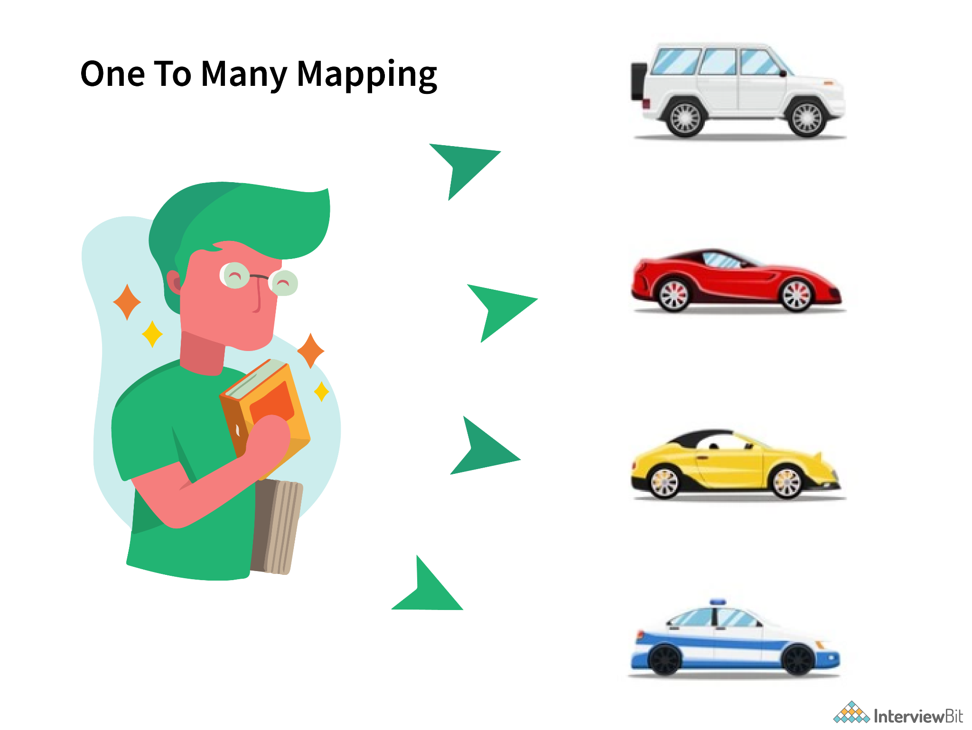
One-To-Many Relationship

Slide 13
One-To-Many Relationship (continued)
In a one-to-many relationship, each row of one entity is referenced to many child records in another entity. The important thing is that child records cannot have multiple parents. In a one-to-many relationship between Table A and Table B, each row in Table A is linked to 0, 1, or many rows in Table B.
A @OneToMany association occurs when each record in one table corresponds to multiple records in a related table. In other words, we can say that the One-To-Many mapping comes into the category of collection-valued association where an entity is associated with a collection of other entities. In this type of association, the instance of one entity can be mapped with any number of instances of another entity.
In a one-to-many relationship, a parent entity can have multiple child entities. In order to define the multiple child entities in the parent entity, Hibernate API allows us to use Collection type (List,Set,Map) to define multiple child entities.

Slide 14
One-To-Many Relationship (continued)
@OneToMany association must create an intermediate table called “Join Table” that holds two foreign key columns. One foreign key column refers to the source table; the other foreign key column refers to the target table.
Having a unique foreign key for the target table also means that our collection (java.util.Collections) cannot have duplicates. A One-to-Many mapping can be implemented using a Set<E> java collection that does not contain any duplicate element so that every record is unique.

Slide 15
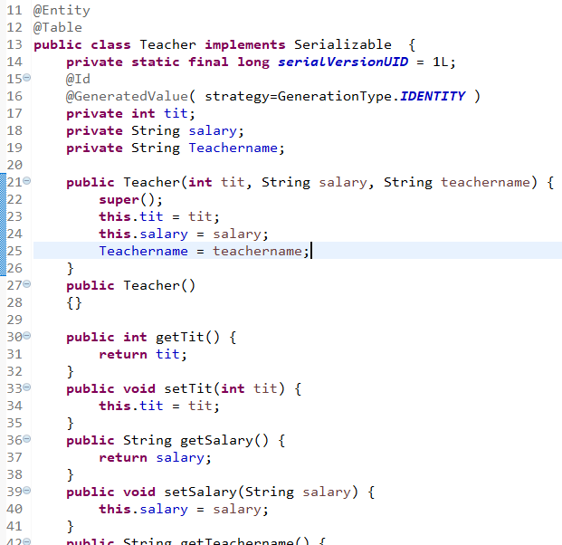
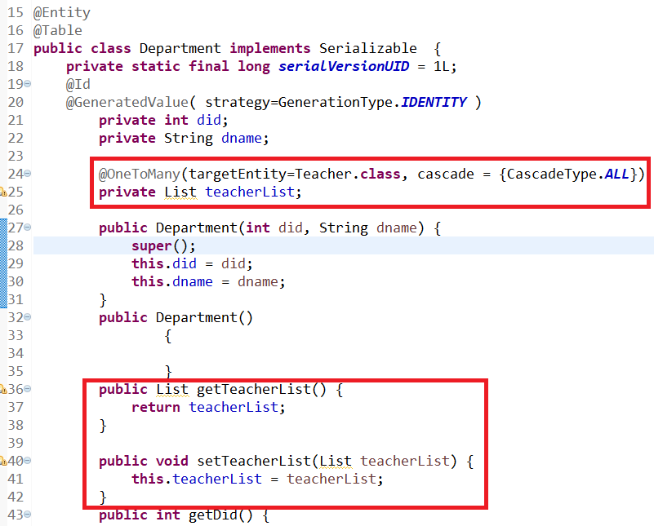
One-To-Many Relationship Example
Teacher.java Class
Department.java Class
Teacher Entity and Department Entity
Notes:
The code shown above is just a screenshot; the full code will be shown in the next lab.The instructor will provide the Demonstration of a onetoMany relationship.

Slide 16


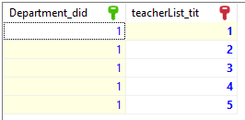
One-To-Many Relationship Example
Teacher Entity and Department Entity
App.java Class
- continued
public class App { public static void main( String[] args ) { SessionFactory factory = new Configuration().configure().buildSessionFactory(); Session session = factory.openSession(); Transaction t = session.beginTransaction(); Teacher t1 = new Teacher(); t1.setTeachername("Haseeb"); t1.setSalary("100");
Teacher t2 = new Teacher(); t2.setTeachername("Jenny Finch"); t2.setSalary("10000");
Teacher t3 = new Teacher(); t3.setTeachername("James"); t3.setSalary("25000");
Teacher t4 = new Teacher(); t4.setTeachername("SID ROSE"); t4.setSalary("3000");
Teacher t5 = new Teacher(); t5.setSalary("200"); t5.setTeachername("Ali");
App.java class with the main() method to run the application (see left screenshot). We are adding a few Teacher’s records along with their Departments.
//Add teacher entity object to the list List<Teacher> teachlist = new ArrayList(); teachlist.add(t1); teachlist.add(t2); teachlist.add(t3); teachlist.add(t4); teachlist.add(t5); session.persist(t1); session.persist(t2); session.persist(t3); session.persist(t4); session.persist(t5);
//Creating Department Department department = new Department(); department.setDname("Development"); department.setTeacherList(teachlist); //Storing Department session.save(department); t.commit(); } }
Result

Slide 17
Hands On LAB: Many-to-One and One-to-Many
Complete the following labs, you can find these labs on Canvas under the Assignment section.
For Eclipse users: GLAB - 305.5.1 - Demonstration to ManyToOne and OneToMany Relationships and Mapping
For IntelliJ users: GLAB - 305.5.1B - Demonstration to ManyToOne and OneToMany Relationships and Mapping with IntelliJ Ultimate
If you have any technical questions while performing the lab activity, ask your instructors for assistance.

Slide 18
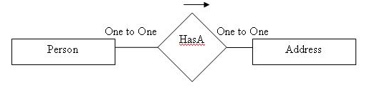
One-To-One Relationship
A @OneToOne association occurs when there is exactly one record in a table that corresponds to exactly one record in a related table. In this case, both tables will contain the same number of records, and each row of the first table is linked to another row in the second table.
A one-to-one relationship is where Table A has a special column (foreign-key column) referencing to the primary key column of Table B. Table A is known as the child-table; Table B is known as the parent-table.
In Hibernate, there are three ways to create one-to-one relationships between two entities.
Use Foreign Key association (we will use this technique in this course).
Use JOIN table.
Use shared primary key.
Let’s consider an example of the relationship between Person and Address entities:
The Person can have one address and one address belongs to one person only.

Slide 19
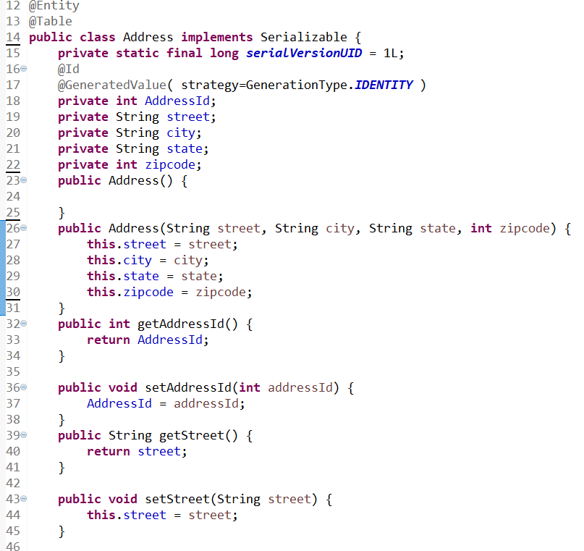
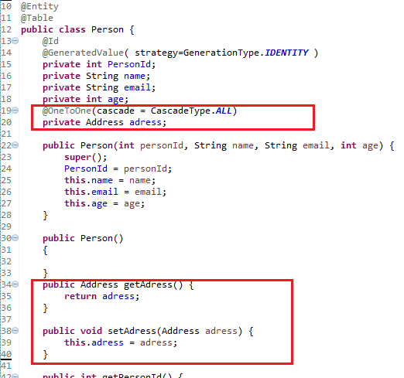
Example: One-To-One Relationship
Person Entity and Address Entity
Address.java Class
Person.java Class
Notes:
The code shown above is just a screenshot; the full code will be shown in the next lab. The instructor will provide the Demonstration to onetone relationship.

Slide 20


Example: One-To-One Relationship
Person Entity and Address Entity
App.java Class
- continued
public class App { public static void main( String[] args ) { SessionFactory factory = new Configuration().configure().buildSessionFactory(); Session session = factory.openSession(); Transaction t = session.beginTransaction(); Address a1 = new Address(); a1.setCity("nyc"); a1.setState("NY"); a1.setStreet("27th street"); a1.setZipcode(11103); Address a2 = new Address(); a2.setCity("Bufflo"); a2.setState("NY"); a2.setStreet("28th street"); a2.setZipcode(15803); Person p1 = new Person(); p1.setAge(25); p1.setEmail("e.jon@email.com"); p1.setName("elbert Adam"); p1.setAdress(a1); Person p2 = new Person(); p2.setAge(45); p2.setEmail("ch.fink@email.com"); p2.setName("Christ fink"); p2.setAdress(a2); session.persist(p1); session.persist(p2); session.persist(a1); session.persist(a2); t.commit(); } }
App.java class with the main() method to run the application. We are adding a few people’s records, along with their addresses.
Result:
One Person can have only one Address. Similarly, an Address will be associated with one Person only. It is one-to-one relationship for this example.
AddressId is the primary key in the Address table.
adress_AddressID is the foreign-key column in the Person table

Slide 21
Hands On LAB: One-To-One Relationship
Please complete the following labs. You can find these labs on Canvas under the Assignment area.
For Eclipse users: GLAB - 305.5.2A - Demonstration of @OneToOne Relationship and Mapping
For IntelliJ users: GLAB - 305.5.2B - Demonstration of OneToOne with Relationship and Mapping in IntelliJ Ultimate
If you have any technical questions while performing the lab activity, ask your instructors for assistance.

Slide 22
Many-To-Many Relationship
A Many-to-Many relationship is where one or more rows from one entity are associated with more than one row in another entity.
@ManyToMany association must create an intermediate table called a Join Table that holds two foreign key columns. One foreign key column refers to the source table; the other foreign key column refers to the target table.
In the join table, there is no unique key constraint on any of the two foreign key columns so that many-to-many multiplicity can be achieved.
Having no unique foreign key in the join table also means that the collection can have duplicates, and the same target entity can be shared among different instances of the source entity's collection.
Typical examples for such a many-to-many association are (Products and Stores), (Class and Teacher), (employees and projects), and (groups and users).
In Hibernate, there are two ways to create many-to-many relationships between two entities:
Using Foreign Key association
Using JOIN table.

Slide 23
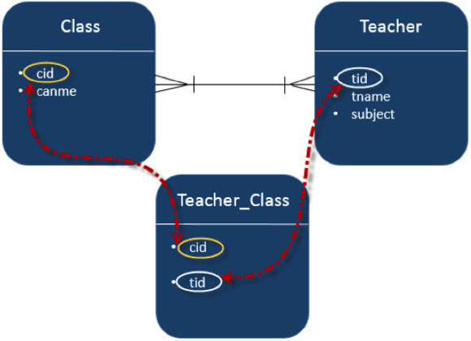
Example: Many-To-Many Relationship
Cohort and Teacher Models
Let’s consider an example of the relationship between Class and Teacher entities.
@ManyToMany annotation uses any entity class that you would consider as owner of the relationship. The owner of the association should have the @ManyToMany annotation.
In our case, the Teacher entity class is the owner side, and the Class entity is the other side.
continue…
source: javatell.com

Slide 24
Example: Many-To-Many Relationship
Cohort and Teacher Models
continued
- continued
Cohort.java Class
Teacher.java Class
@Entity @Table(name="cohort") public class Cohort{ @Id @GeneratedValue( strategy=GenerationType.IDENTITY ) private int cid; private String CName; private String duration; public Cohort( String cName, String duration) { this.CName = cName; this.duration = duration; } public int getCid() { return cid; } public void setCid(int cid) { this.cid = cid; } public String getCName() { return CName; } public void setCName(String cName) { CName = cName; } public String getDuration() { return duration; } public void setDuration(String duration) { this.duration = duration; } }
@Entity @Table(name="Teacher") public class Teacher{ @Id @GeneratedValue( strategy=GenerationType.IDENTITY ) private int tit; private String salary; private String Teachername; @ManyToMany(targetEntity = Cohort.class) private Set CohortSet; public Teacher(String salary, String teachername, Set CohortSet) { this.salary = salary; this.Teachername = teachername; this.CohortSet = CohortSet; } public Teacher() { } public Set getCohortSet() { return CohortSet; } public void setCohortSet(Set cohortSet) { CohortSet = cohortSet; } public int getTit() { return tit; } public void setTit(int tit) { this.tit = tit; } public String getSalary() { return salary; } public void setSalary(String salary) { this.salary = salary; } public String getTeachername() { return Teachername; } public void setTeachername(String teachername) { Teachername = teachername; } }
We used a Set collection that does not contain any duplicate elements.
We can see that the Teacher class has a collection (Set) of elements because when you map a ManyToMany association, you should use a Set instead of a List as the attribute type. Otherwise, Hibernate will take an inefficient approach to remove entities from the association. It will remove all records from the association table and re-insert the remaining ones. You can avoid that by using a Set instead of a List as the attribute type.
Notes:
As you can see, The Teacher entity class has the @ManyToMany annotation. ManyToMany annotation is used at any entity class that you would consider as owner of the relationship. The owner of the association should have the @ManyToMany annotation. In our case, the Teacher entity class is the owner side and the Cohort (class) entity is the other side.

Slide 25


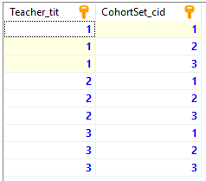
Example: Many-To-Many Relationship
Cohort and Teacher Models
continued
- continued
public class App { public static void main( String[] args ) { SessionFactory factory = new Configuration().configure().buildSessionFactory(); Session session = factory.openSession(); Transaction t = session.beginTransaction(); //----Create Cohort/class Entity set one---- Cohort Class1 = new Cohort("Java Developer", "14 weeks"); Cohort Class2 = new Cohort("FullStack Developer", "7 Weeks"); Cohort Class3 = new Cohort("Python Developer", "12 Weeks"); //------ Store Cohort/ Class -------- session.persist(Class1); session.persist(Class2); session.persist(Class3); //-----Create Cohort/Class one -------- Set<Cohort> ClassSet1 = new HashSet<Cohort>(); ClassSet1.add(Class1); ClassSet1.add(Class2); ClassSet1.add(Class3); //-----Create Cohort/Class two -------- Set<Cohort> ClassSet2 = new HashSet<Cohort>(); ClassSet2.add(Class2); ClassSet2.add(Class3); ClassSet2.add(Class1); //-----Create Cohort/Class three -------- Set<Cohort> ClassSet3 = new HashSet<Cohort>(); ClassSet3.add(Class3); ClassSet3.add(Class1); ClassSet3.add(Class2); Teacher t1 = new Teacher("100", "Haseeb", ClassSet1); Teacher t2 = new Teacher("200", "Jenny", ClassSet2); Teacher t3 = new Teacher("200", "Charlie", ClassSet3); session.persist(t1); session.persist(t2); session.persist(t3); t.commit(); } }
Both Cohort and Teacher have ManyToMany relations. The intermediate (join) table is created by the name of the teacher_cohort, containing two foreign keys; one of them refers to the Teacher’s primary (Teacher_tit) key and the other refers to the Cohort’s primary Key.
There is no way to avoid the join table solution for achieving a ManyToMany association because if you thought that you could achieve it through any other technique (e.g., adding new columns, or comma separated values), you are almost getting a performance issue.
Teacher Table
Cohort Table
teacher_cohort Table

Slide 26
Hands-On LAB - Many-to-Many Relationship
Please complete the following labs. You can find these labs on Canvas under the Assignment area.
For Eclipse users: GLAB 305.5.3 - Demonstration of @ManytoMany Relationship and Mapping
For IntelliJ users: GLAB - 305.5.3B - Demonstration of @ManytoMany Relationship and Mapping in Intellij Ultimate
If you have any technical questions while performing the lab activity, ask your instructors for assistance.

Slide 27
Knowledge Check
What is a One-to-One association in Hibernate?
What is a One-to-Many association in Hibernate?
What is a Many-to-Many association in Hibernate?

Slide 28
Summary
Hibernate mappings are one of the key features of hibernate. They establish the relationship between two database tables as attributes in your model that allows you to easily navigate the associations in your model and queries.
You can establish either unidirectional or bidirectional mapping. You can either model them as an attribute on only one of the associated entities or on both. It will not impact your database mapping tables, but it defines in which direction you can use the relationship in your model and queries.
The relationship that can be established between entities are:
one to one — it represents the one-to-one relationship between two tables.
one to many/many to one — it represents the one-to-many relationship between two tables.
many to many — it represents the many-to-many relationship between two tables.

Slide 29

Questions?
27

Slide 30
References
https://en.wikibooks.org/wiki/Java_Persistence/Relationships#Join_Fetching
https://www.logicbig.com/tutorials/java-ee-tutorial/jpa/jpql-literals.html
http://leakfromjavaheap.blogspot.com/2013/01/basic-jpa-mappings.html
https://en.wikibooks.org/wiki/Java_Persistence/Mapping
https://en.wikibooks.org/wiki/Java_Persistence/ManyToOne
https://howtodoinjava.com/hibernate/hibernate-one-to-one-mapping/

Slide 31

End of Module
30

